Slide 1

At your fingertips
CliniPEARLS
August 18, 2011
Tracy Thain, Bradut Dima, Janice Tian

Slide 2
Introduction - What is CliniPEARLS?
CliniPEARLS is:
a technology framework that allows for the publication of guidelines/documents on various PDA and smartphone devices
CliniPEARLS is composed of:
a flexible security and administration structure that allow users to subscribe to guidelines from multiple organizations
a central place to enter the guideline content by either internal editors or external contributors with the appropriate permissions
4 client applications on various handheld devices that can be used even when there are no internet capabilities available
a mechanism that ensures users can obtain the latest guidelines and update their existing ones

Slide 3
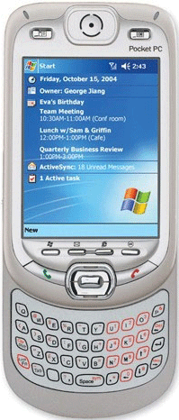



What does this really mean?
Web Server
Web
CliniPEARLS is a means for healthcare providers to quickly and easily get up-to-date information at the point of care
PDA
iPhone
Applications
Blackberry
Content Management
SQL
Administration
Database Server

Slide 4
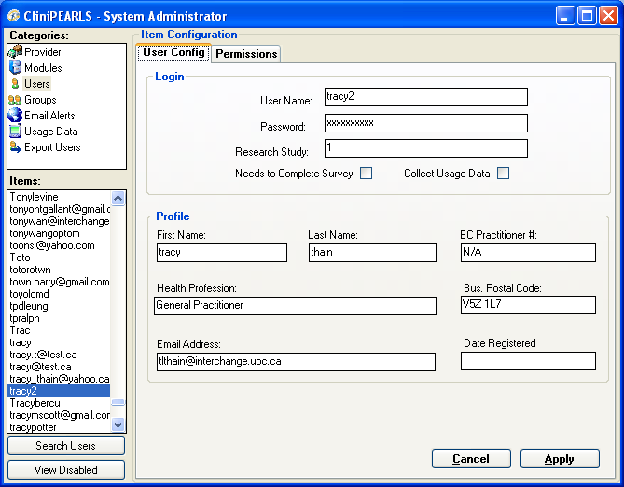
The Applications: Administration
Purpose:
Allows for control of:
Providers (i.e. GPAC)
Guidelines
Users
Groups of users
E-mails

Slide 5
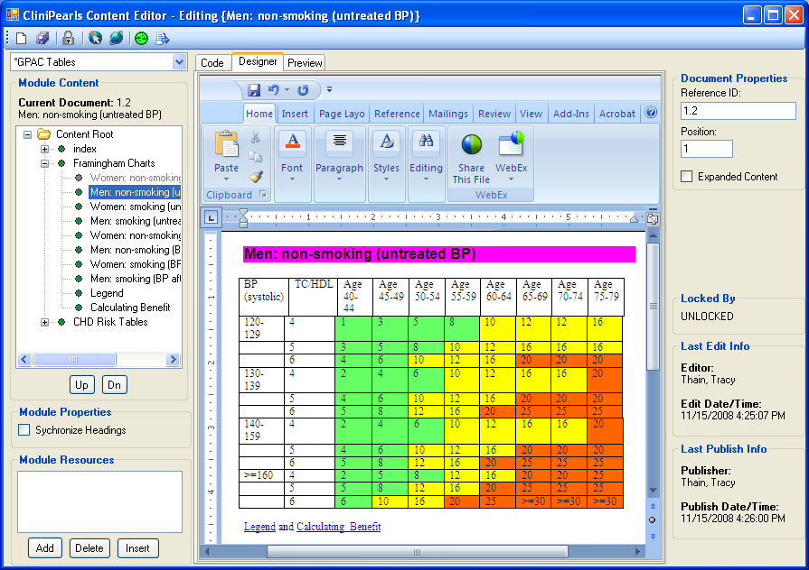
The Applications: Content Editor
Purpose:
Add, delete, or edit content for all guidelines

Slide 6
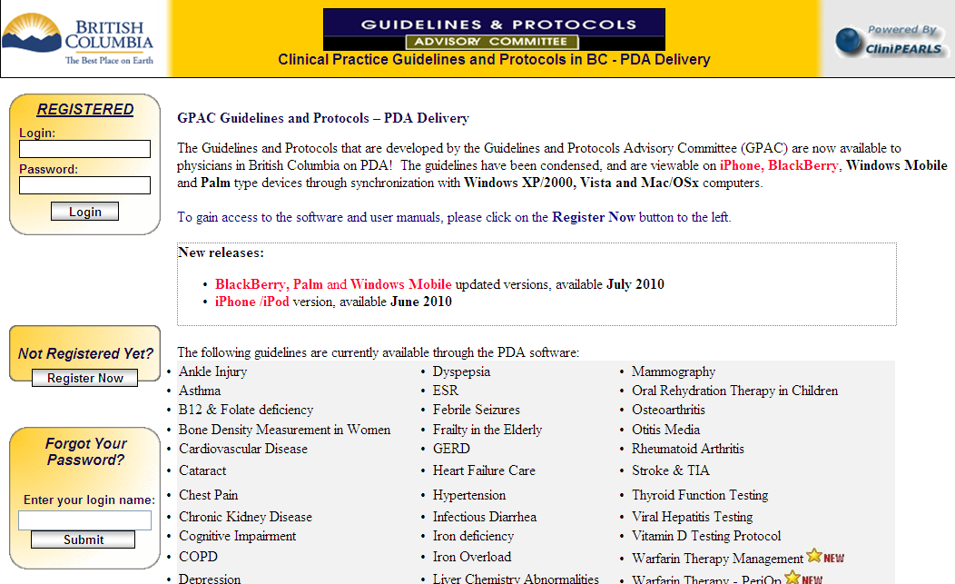
The Applications: Web Site
Purpose:
Registration of users
Download of mobile applications
Contact and help information
Online access to the condensed guidelines

Slide 7
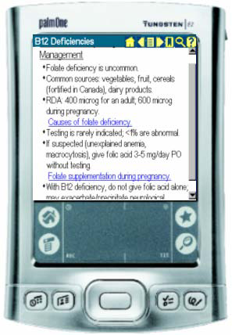
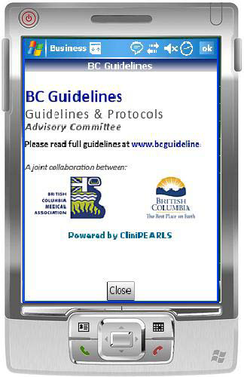
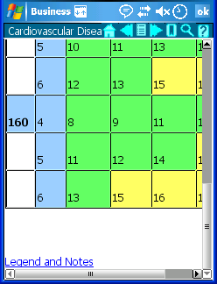
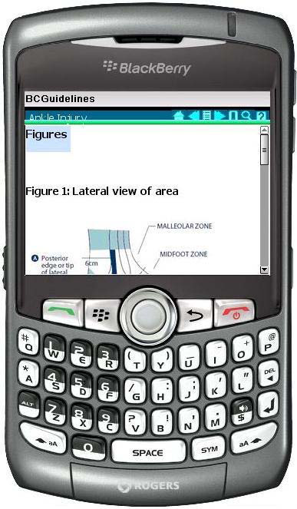
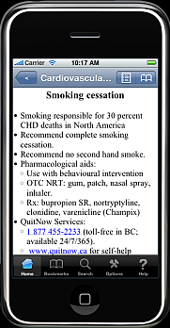
The Applications: Mobile Devices
Purpose:
Access the guidelines at the point of care

Slide 8
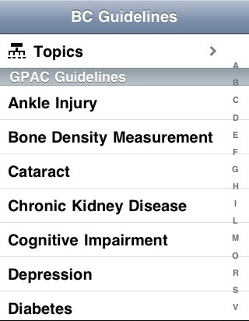
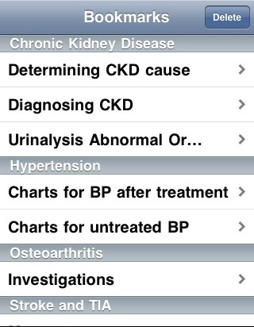
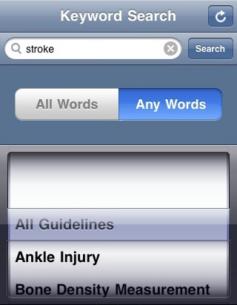
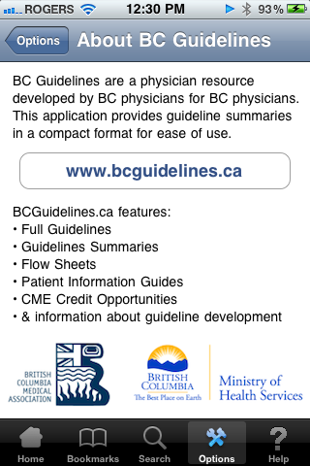
The Applications: Mobile Devices

Slide 9
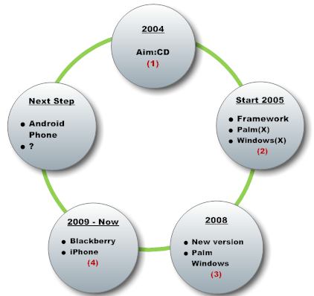
CliniPEARLS Milestones

Slide 10
CliniPEARLS Statistics
Total number of registered users?

Slide 11
CliniPEARLS Statistics
Area of residence for registered users World Wide:

Slide 12
CliniPEARLS Statistics
Distribution of registered users by profession in BC:

Slide 13
CliniPEARLS Statistics
Percentage of mobile devices used by the registered users:

Slide 14
CliniPEARLS Statistics
Top five most used guidelines:
Diabetes
Heart Failure Care
Depression
B12 Deficiencies
Cardiovascular Disease

Slide 15
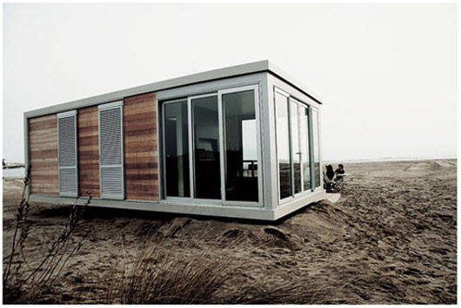

Challenges & Next steps
  Let’s consider an analogy between our Office and …a construction company:
  Our construction company normally builds top quality residential houses in Canada and USA.
  Now it is time to size the opportunity and approach a new flourishing business: vacation houses!”

Slide 16
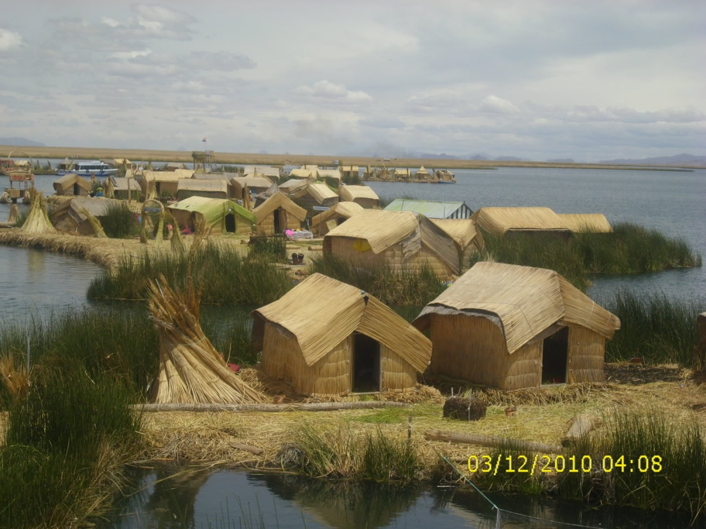
Challenges & Next steps
vacation houses in Peru:
Floating reed islands of lake Titicaca,
Altitude: 3,811 m (12,500 ft)

Slide 17

Challenges & Next steps
vacation houses in Greece:
Mount Metéora (Greek: "suspended in the air")

Slide 18
Challenges & Next steps
Challenges:
Cannot translate our local building experience to these types of buildings.
  Need time to learn the local building codes. May need to buy new equipment too.
  Cannot afford to split our small team if we want to both stay business in BC besides expanding abroad

Slide 19
Challenges & Next steps
Possible approaches:
  Learn how to build like a native specialist.
  Find a means to continue building in our company’s traditional fashion.

Slide 20
Challenges & Next steps
Build like a native specialist:
Benefits:
  Our products will display a ‘native’ look and feel.
Drawbacks:
  Costs [training, hiring experts, etc.]
  These types of ‘hot’ markets can vanish suddenly
  Cannot reuse the new skills and equipment.

Slide 21
Challenges & Next steps
Continue building in our company’s traditional fashion:
Suppose we can use a third party product, a platform, whose makers claim that it can be deployed everywhere (lakes, mountains, etc.) to serve as a foundation for any type of buildings.
This means that we can build our classic houses on top of this platform without worrying about new skills and equipment.

Slide 22
Challenges & Next steps
Benefits of using a unifying platform:
  Can reuse our experience across different locations
    Saves considerable amounts of time and money
    Allows us a quick response when approaching future locations
    Reduces our losses when a certain markets disappear

Slide 23
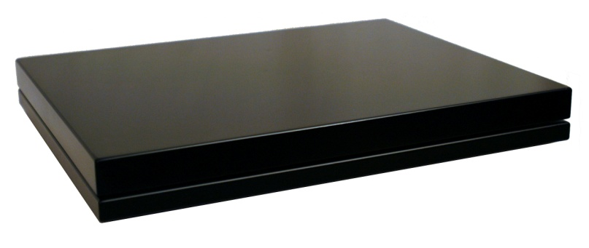



Challenges & Next steps

Slide 24
Challenges & Next steps
Drawbacks of using platforms:
  Platforms may not be available for some locations,
  They add a level of complexity, since we now deliver to our client our product + the platform,
  Our products may not have the same look and feel as the native ones, which may affect our success

Slide 25

Challenges & Next steps
Drawbacks of using platforms [continued]:
  Platforms’ limitations may affect our product,
  No matter how good is our product, if the platform fails, we will take the blow!

Slide 26
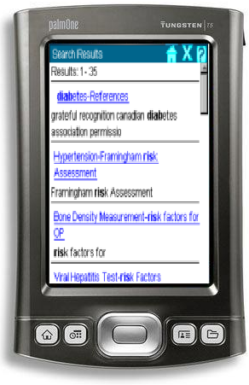
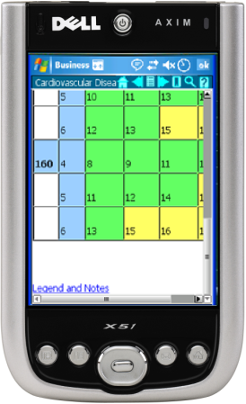
Challenges & Next steps
How does this relate to CliniPEARLS?
By the beginning of 2008, our office was delivering CliniPEARLS for Palm OS and Windows Mobile for about three years
Problem: Loss of productivity because of using different programming languages!
  work and experience could not be translated between the two types of devices
  work duplication: each new feature/modification to the program needed to be implemented from scratch for each type of device.
CliniPEARLS for Palm | CliniPEARLS for Windows Mobile
developed by a contractor, using the “C” programming language [we lacked professional level expertise in “C”] productivity hog : very difficult to improve/modify installed by 80% of our users | developed “in house” using the “C#” programming language in which we had expertise easy to improve and modify

Slide 27
Challenges & Next steps
Solution: use a unifying platform, a piece of software generically referred as a “Virtual Machine”:
  The platform deals with the particularities of several types of devices [Palm, Windows Mobile, BlackBerry, etc.].
  “Build once, deploy everywhere”: we can now write our programs by using a single programming language, and install them on different types of mobile devices [on top of the platform]
Approach: In March 2008 when MoH asked us to redesign the User Interface of CliniPEARLS, we sized this opportunity to do a complete redesign and proceed with the Virtual Machine solution.

Slide 28
Challenges & Next steps
Choosing the Virtual Machine (VM):
  The most reliable and widespread VM is Java,
  On January 2008, Java VM for Palm had been discontinued!
  A Brazilian company, SuperWaba, produced a VM for Palm and Windows Mobile,
  SuperWaba VM was compatible with the Java, so that we could reuse our Java experience
  SuperWaba team had plans to make their VM available to BlackBerry devices.

Slide 29
Challenges & Next steps
Our experience with the SuperWaba Virtual Machine:
The Good:
  Productivity improved significantly since we could focus only on a single application
  It took us less than seven months to deliver a brand new version of CliniPEARLS for Palm and Windows Mobile!

Slide 30
Challenges & Next steps
Our experience with the SuperWaba Virtual Machine:
The Bad:
  Support and documentation left a lot to be desired
    User manuals were poorly written and incomplete leading to wasted time and tons of frustration
  Extra-work was needed to workaround missing features in SuperWaba
  To install our application, users needed to perform an extra-step and install SuperWaba VM

Slide 31
Challenges & Next steps
Our experience with the SuperWaba Virtual Machine:
The Ugly:
  Overhyped:
    SuperWaba falsely claimed that their VM can be installed on Mac computers.

Slide 32
Challenges & Next steps
Conclusions for using a VM for our CliniPEARLS mobile app:
Using a VM was a good choice:
  Increased our productivity significantly
  Saved our work: when Palm and Windows Mobile market shares vanished, our project survived because it was not tightly linked to a specific type of device.
  Allowed us to immediately start the BlackBerry version.

Slide 33
Challenges & Next steps
SuperWaba VM had been discontinued by the end of 2008 and replaced with TotalCross VM, which claimed to have the following features:
    95% compatible with SuperWaba,
    run on Palm, Windows Mobile, BlackBerry and iPhone
CliniPEARLS for iPhone and BlackBerry [2009-2010]

Slide 34
Challenges & Next steps
Challenges with CliniPEARLS for BlackBerry:
TotalCross for BlackBerry proved to be released prematurely and had serious issues. We needed to spend a lot of time and effort to workaround these issues and keep the project afloat. Even now TotalCross VM for BlackBerry still has usability and stability issues.
BlackBerry devices proved to be slow, underpowered, and cumbersome. While they could run simple apps like emails and calendar, they were not appropriate for our feature rich application.
BlackBerry Enterprise Server (BES) [the system which controls all BB devices in organizations like UBC or hospitals] has strict security settings which added a level of complexity to our app.
CliniPEARLS for iPhone and BlackBerry [2009-2010] [contd.]

Slide 35
Challenges & Next steps
CliniPEARLS for iPhone and BlackBerry [2009-2010] [contd.]
Challenges with CliniPEARLS for iPhone :
TotalCross for iPhone could run only on devices if you “JailBreak” them, so that it was not an option. We had, instead, to learn how to program native applications for iPhone.
iPhone development, required learning a new language, “Objective-C” and its “Cocoa” development framework, so there was nothing we could re-use from the Virtual Machine version of CliniPEARLS!
It took about three months to get the iPhone version approved by Apple, due to some communication problems with Apple.

Slide 36
Challenges & Next steps
CliniPEARLS for iPhone and BlackBerry [2009-2010] [contd.]
Conclusions:
  The new TotalCross Virtual Machine was not a project savior to us because:
    The benefit of reusing the code from the Palm/Windows Mobile project was overshadowed by the effort we put in dealing with the issues of the TotalCross VM
    The amount of time needed to address the shortcomings of the TotalCross VM was the same with the one needed to learn native programming and build an iPhone application…
    The VM was difficult to activate, thus deterring our users from our app.
  The amount of effort involved in native development of the iPhone version was worthy since CliniPEARLS for iPhone was an instant success!
  An unreliable Virtual Machine can bring more harm than advantages.

Slide 37
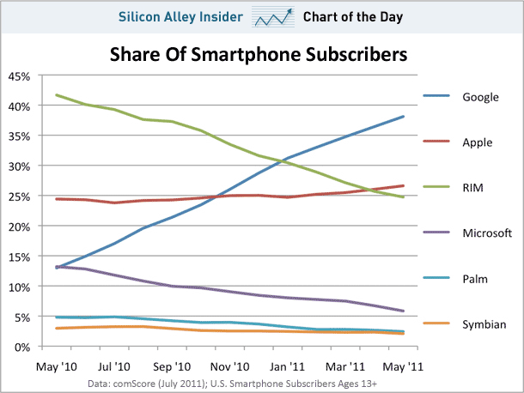
Challenges & Next steps
Next steps. CliniPEARLS for Android [2011?]
CliniPEARLS/iPhone: developing for native platforms can pay off!
But… need to target the right type of devices
What we have now?
  BlackBerry: losing market share
  Android: fastest growing platform
  iPhone: second after Android
  Microsoft, Palm, Symbian: < 5%

Slide 38
Challenges & Next steps
Next steps. CliniPEARLS for Android [2011?]
Which is the best approach?
Native programming using Android Java framework?
Cross-device programming?
  Virtual Machine [e.g. TotalCross VM for Android]
  Website for mobile devices
  WebApps? [Web widgets]

Slide 39
Challenges & Next steps
Next steps. CliniPEARLS for Android [2011?]
Native programming using Android Java framework:
  Makes sense, provided Android’s the popularity

Slide 40
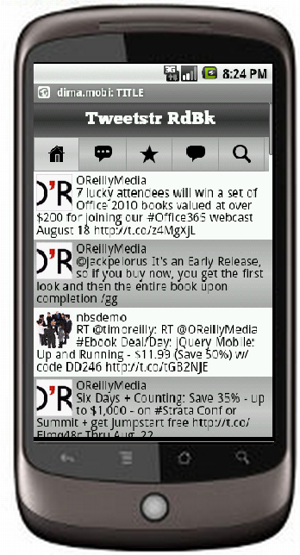
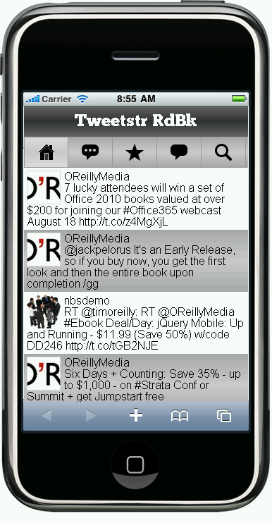
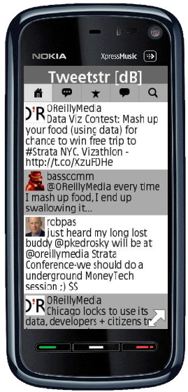
Challenges & Next steps
Next steps. CliniPEARLS for Android [2011?]
Cross device programming? Website for mobile devices [www.clinipearls.ca/m]
Android | iPhone | Nokia | Also available…
 |  |  | Windows 7 [Mango] +[with Opera Mini:] Windows Mobile BlackBerry Featured phones

Slide 41
Challenges & Next steps
Next steps. CliniPEARLS for Android [2011?]
Cross device programming? Website for mobile devices
  Benefits:
    Cross-device compatibility,
    No need to download app, database, etc.
    Users have access to the latest version of application and database
  Drawbacks:
    Devices need a permanent connection to Internet. [which may be limited or forbidden in some locations]
    Devices need a modern browser compatible with the latest standard [HTML5]
    Webs site applications usually are slower than native ones

Slide 42
Challenges & Next steps
Next steps. CliniPEARLS for Android [2011?]
Cross-device programming? WebApps [Web widgets]
  Websites that run on device rather than on the server
  Most modern mobile devices can run WebApps
  May have the same look and feel like a native app
  No need to install additional software [e.g. a VM]
  Challenge: each type of mobile device has its own standards for WebAps
    Solution: WebAps frameworks :
      Native: iPhone, Android, BlackBerry, WebOS
      Cross device: Sencha, PhoneGap,

Slide 43
Challenges & Next steps
Next steps. CliniPEARLS for Android [2011?]
“Getting to grips with mobile[1]
Not all platforms are designed equal – and getting to grips with mobile development can be a major investment of time and effort, depending on which platform you choose to learn.
Android and Qt are by far the easiest platforms to learn, with respondents requiring an average of under six months to master.
[…] mobile web isn’t such an easy platform to learn, ranking sixth in terms of learning curve. […]This is not due to the complexity of any one language like HTML or JavaScript, but due to the need for web developers to learn a complex stack of languages and technology frameworks across client and server environments, in addition to having to battle with the challenges of cross-browser portability.”
[1] VisionMobile-Developer_Economics_2011, http://www.visionmobile.com/rsc/researchreports/VisionMobile-Developer_Economics_2011.pdf

Slide 44
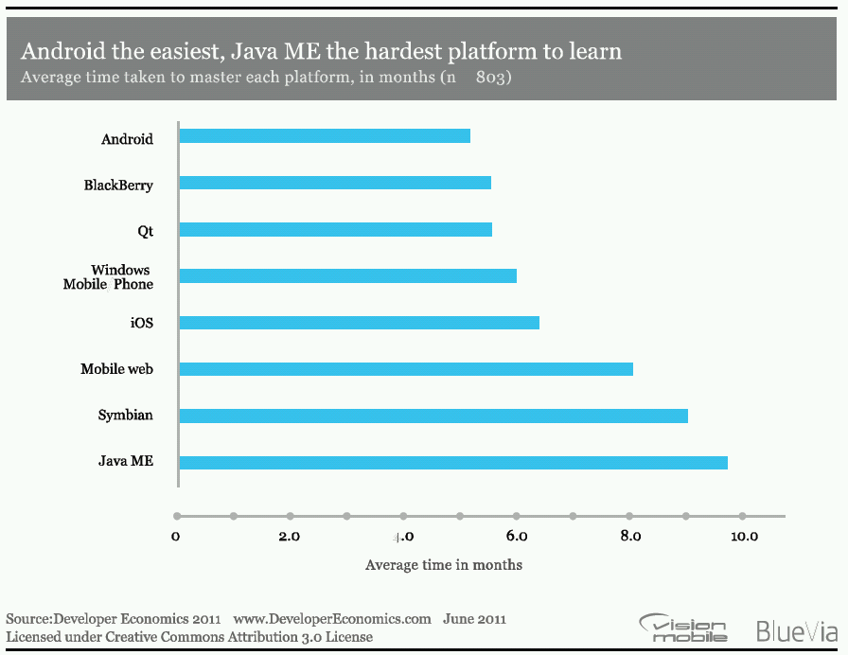
Challenges & Next steps
Next steps. CliniPEARLS for Android [2011?]
The chart illustrates the relative learning curve per platform, and how not all
platforms are born equal.

Slide 45
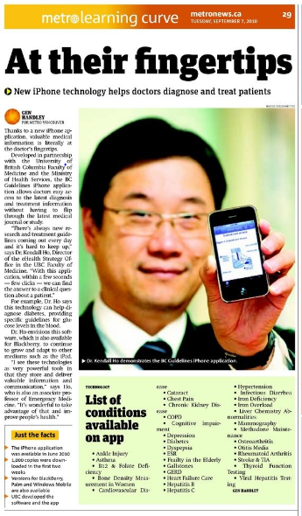
Q&A

