Slide 1
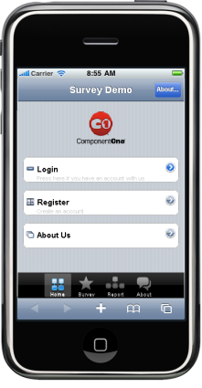
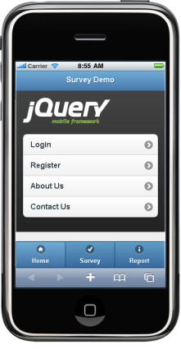
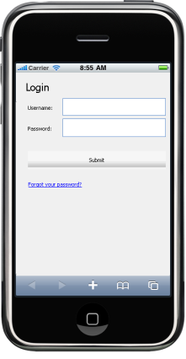
Comparison of three mobile site development frameworks
Component One | JQuery Mobile | Visual WebGUI

Slide 2
Comparison of three mobile site development frameworks
Learning Curve | Very Good Can use our ASP.NET skills. | Very Good HTML5 syntax, based on JQuery and JQuery UI foundation | Good Same as other .Net GUI Toolkit
Efficiency of the development tools | Very good Uses MS Visual Studio, with dedicated iPhone controls | Good Online drag-and-drop UI builder included | Good Uses MS Visual Studio, able to drag and drop GUI control to designer
Developer Support | Poor Their tech support failed to answer any of our questions during the evaluation period. | Poor | Fair Offer technical support package and community forum
Documentation | Fair Users Forums and examples | Good Decent library of examples | Good Have different version documentation
Aesthetics | Very Good ‘iPhonish’ Aspect. However customization is not easy | Very Good Supports easy theming, styling with CSS or online tools | Good ‘HTML5’ Aspect

Slide 3
Comparison of three mobile site development frameworks
Speed | Fair | Fair Requires initial download of 61kb library. After that, execution speed is fairly smooth. | Fair
Cross Platform | Good iPhone: very good Android: good Nokia: fair Blackberry: ? | Very Good 3 level “degradable” platform support: A: Full Experience B: Full Experience Minus AJAX C: Basic HTML | Bad iPhone: good Android: slider not working Nokia: fair Blackberry: ?
Price | $1100 / developer with Platinum Support $677 / developer Subscription Renewal License | Free Open-Sourced | $749 Pro Studio with 1 year subscription $1399 Pro Studio with 2 year subscription
Conclusion | Good for rapid development, prototyping, Speed and compatibility with some devices may be a concern | Good for building graphical elements on the mobile. Compatible with broad range of mobile devices that degrades with less capable browsers. | Easy to learn how to use. But the toolkit is still too buggy

Slide 4
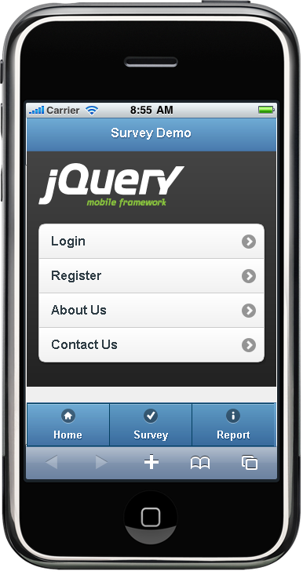
Component One | JQuery Mobile | Visual WebGUI
Main screen

Slide 5
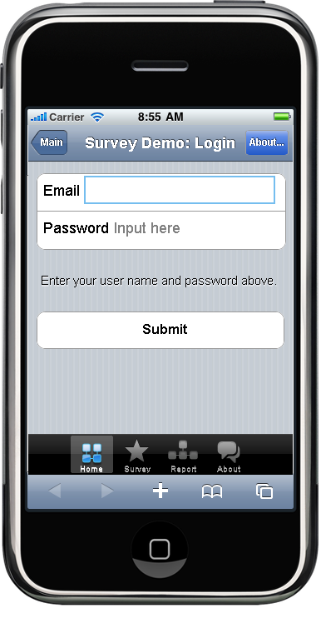
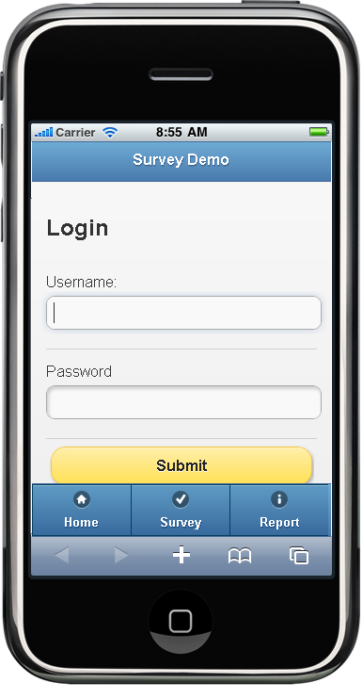
Component One | JQuery Mobile | Visual WebGUI
Login screen

Slide 6
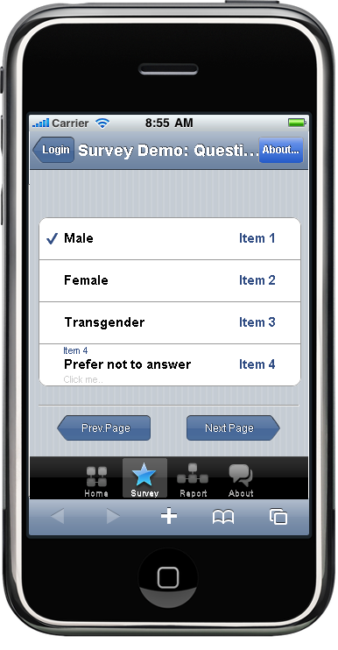
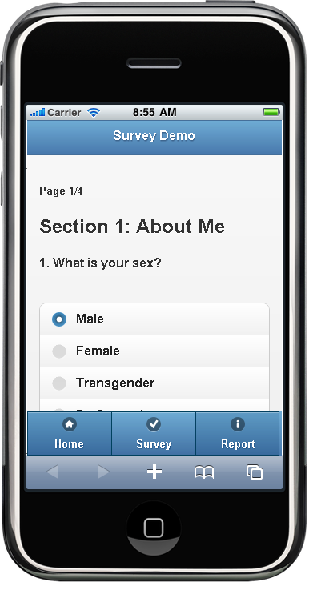
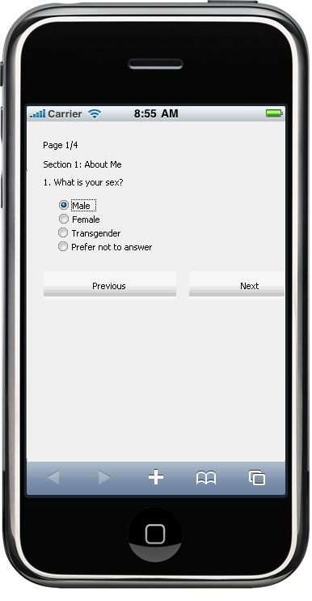
Component One | JQuery Mobile | Visual WebGUI
Single selection

Slide 7
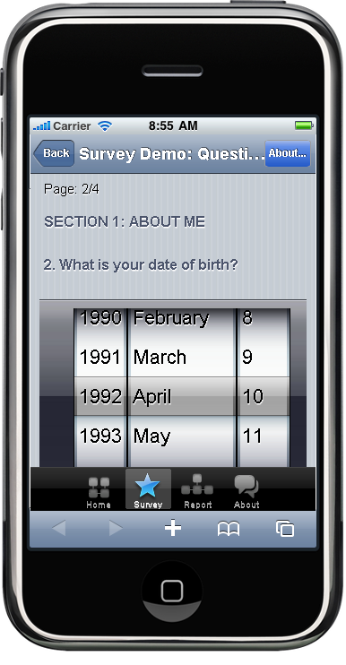
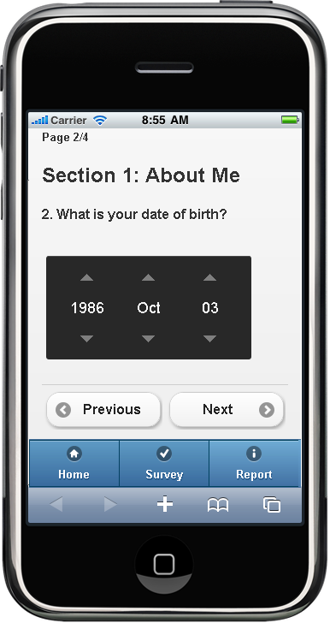
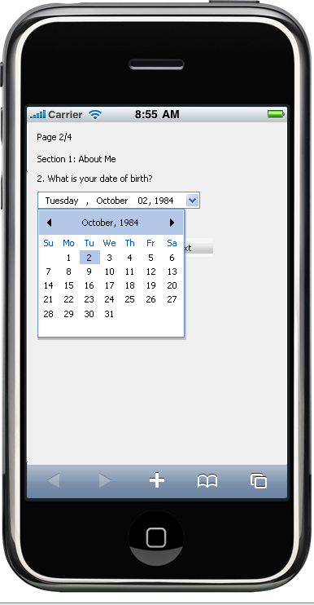
Component One | JQuery Mobile | Visual WebGUI
Date picker

Slide 8
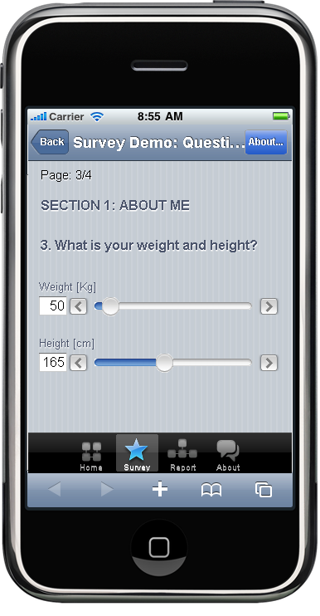
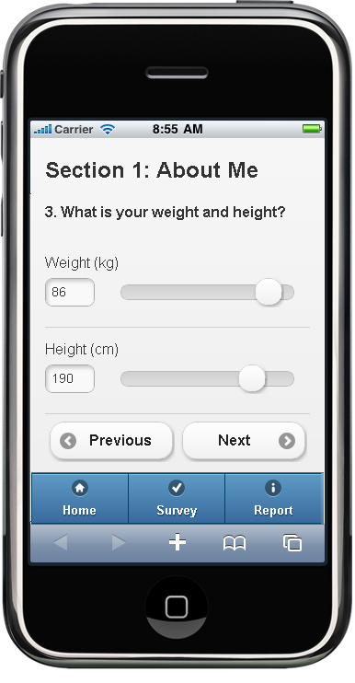
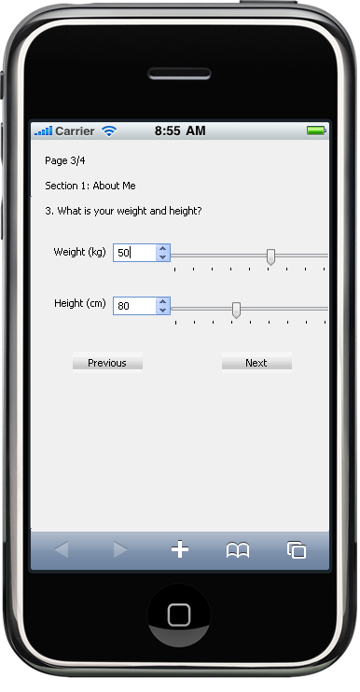
Component One | JQuery Mobile | Visual WebGUI
Slider

Slide 9
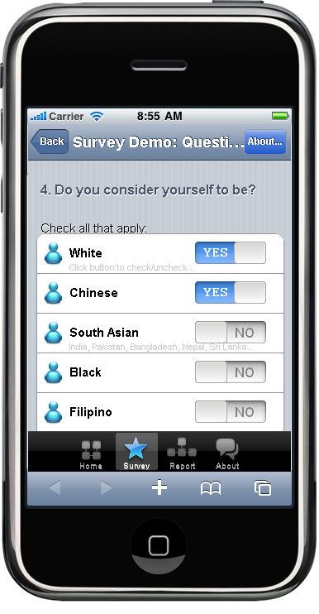
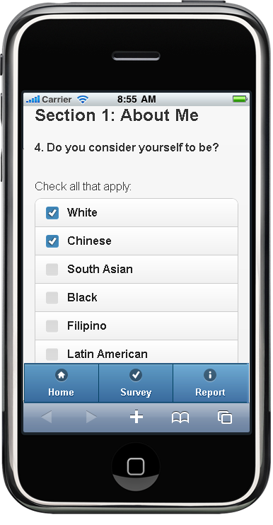
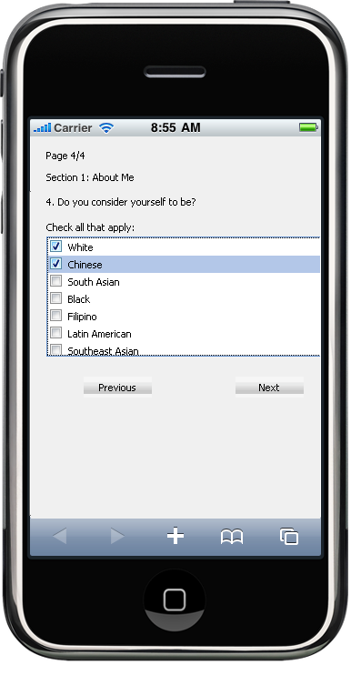
Component One | JQuery Mobile | Visual WebGUI
Checkbox

Slide 10
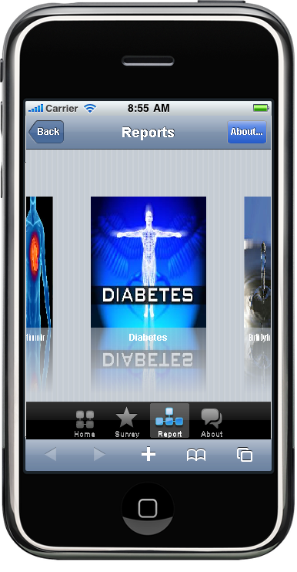
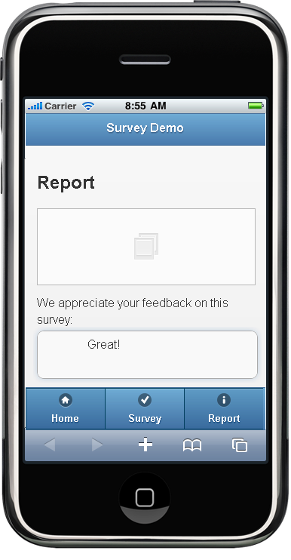
Component One | JQuery Mobile | Visual WebGUI

Slide 11
Try these examples on our dev website, at http://137.82.134.27/mobile

Slide 12
Creating an off line Web application with HTML5
HTML is a programming language used for building and displaying web pages.
Its latest edition is HTML5 which offers cool features such as:
Better aspect : native support for rounded corners, gradient colors,
Multimedia: HTML5 can render video and audio without the need of third party plugins such as Adobe Flash.
Local storage: web applications can store fair amounts of data on the user’s device.
Off line functionality: Developers can write web application that can run locally on the phone browser, without an internet connection.

Slide 13
Websites, Web applications, Off-line Web Applications, Native Application
HTML5 offers users a better experience, beyond of the traditional websites and web applications.
To demonstrate this, we have created an off-line Web application, which we transformed later into a native application that can be downloaded on Android devices, and which uses phone’s vibration and geo-location services.
First of all, we will review the distinguish characteristics of:
Websites,
Web applications,
Off-line Web Applications,
Native Application

Slide 14
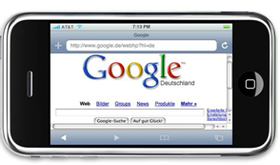
1. Websites:
Consist of web pages and services hosted on a remote servers
Users only consume info by browsing web pages
Users need internet access to those servers
Everything [web pages, databases] is stored on the server
Examples: Google search☺
Figure 1: mobile website

Slide 15
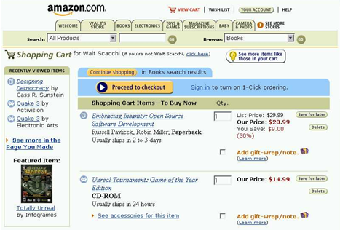
2. Web applications:
Consist of web pages or services that allow user to accomplish some tasks
Users can consume, produce or manipulate info.
Users need access to Internet
Everything [web pages, databases] is stored on the server
Examples:
reservation and/or payment systems [e.g. Amazon],
calories counting application [Figure 2.b]
Figure 2.a) Web application: Amazon shopping cart

Slide 16
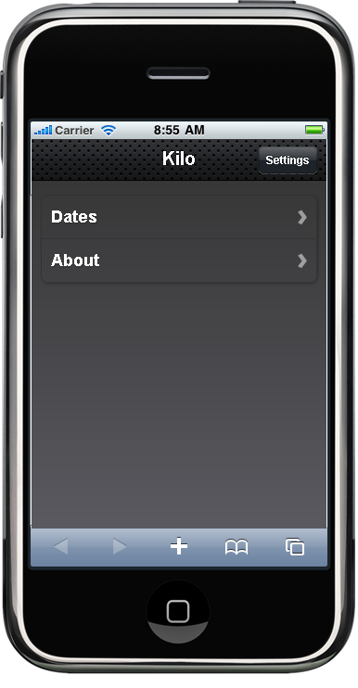
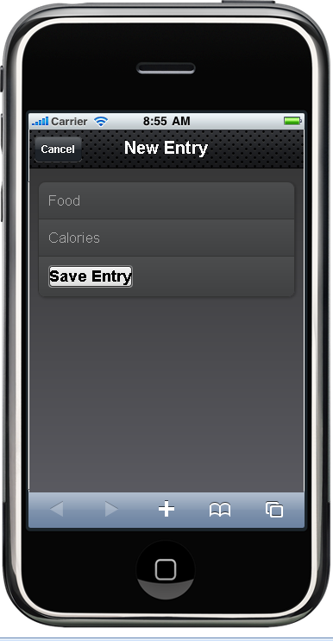
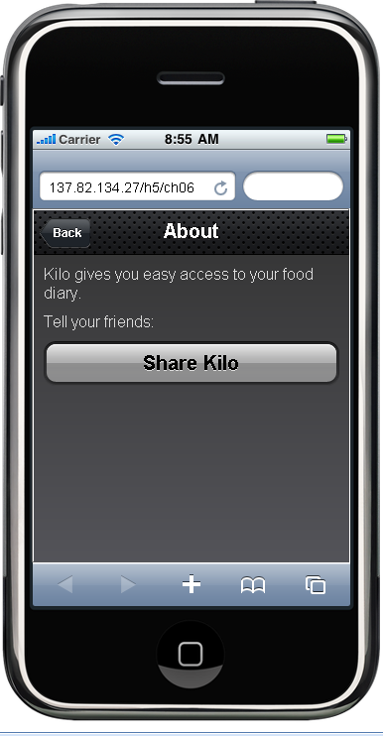
2. Web applications:
Figure 2.b) Web application: Kilo - a calories counting application.^{[1]}
[As seen on our development server at http://137.82.134.27/mobile]
[1]: web app developed by following the examples in the book “Building iPhone Apps with HTML, CSS, and JavaScript” by J. Stark

Slide 17
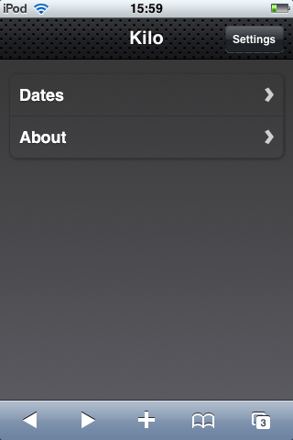
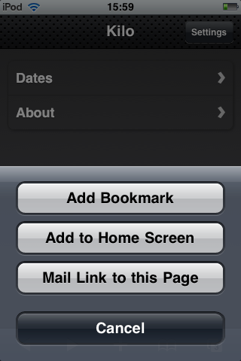
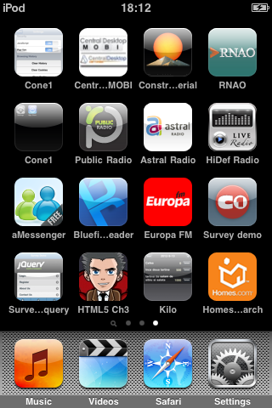
3. Offline Web applications:
HTML5 apps can run offline on devices that support this feature. Offline web apps can use data stored on device into a local database.
To make a web application run locally on iPod, for instance, tap on the “+” sign at the bottom of the screen, and then select “Add to Home Screen” as seen in Figure_3.
After that, the app can be launched from icon on the iPod’s home screen, even without internet connection!
Figure 3: How to store a web application into an iPod touch
Launch App

Slide 18
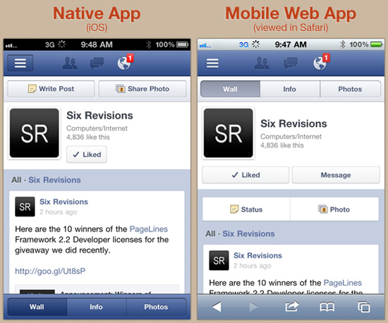
3. Off line Web applications [continued]:
A well written web app can look and behave like a native one, as seen in Figure 4:
Figure 4: Side-by-side look at Facebook’s native app and mobile web app:
[source: http://sixrevisions.com/mobile/native-app-vs-mobile-web-app-comparison/]

Slide 19
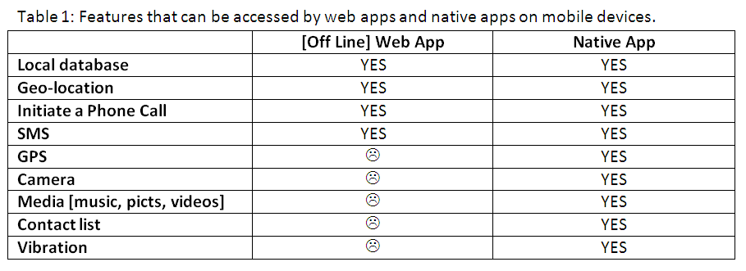
4. Native and Hybrid applications:
While off line Web Application can run …well, off line, and look and behave like native apps, they can access only a limited set of the features on the mobile phones, as seen in Table 1

Slide 20
4. Native and Hybrid applications [continued]:
To overcome these limitations, there are two possibilities:
Write a pure native app, which may not practical when targeting more than two types of devices, since, for instance, the same app developed for Android will not run on iPhone.
Create a hybrid app, which is a Native App with a Web App Inside. With a hybrid app, the entire user interface appears in a browser window, with a native app wrapped around it to provide access to device functionality not available via the browser ^{[1]}.
By using a specialized tool, PhoneGap, we were able to transform our WebApp into an Android hybrid app that can be downloaded from our development website. In this new incarnation, our app is now able to access the vibration and geo-location features of the cell phones.
PhoneGap offers a cloud based service that can transform a HTML5 web applications into hybrid for a large number of devices: iPhone/iPad/iPod, Android, Symbian [Nokia], BlackBerry, Samsung Bada, WebOS, Windows Phone
[1] Source: Lionbridge: Mobile Web Apps vs. Mobile Native Apps: How to Make the Right Choice

Slide 21
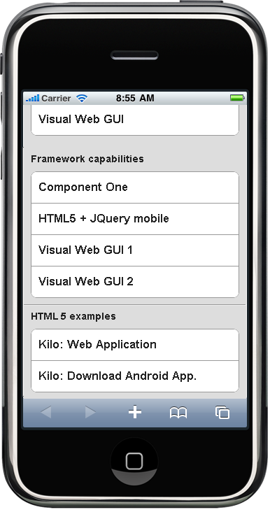
Try these examples on our dev website, at http://137.82.134.27/mobile

Slide 22
QUESTIONS?

